Slide 1

Business & Finance
Policies & Procedures Training
07/28/2021

Slide 2
Purchasing
Purchase Order
No Purchase Order
Purchasing Cycle
Requisition
Purchase Order
Receiving Report
(for goods)
Invoice
Payment
Purchasing Cycle
Requisition
Order
(by Unit)
Payment
(by Unit PCard)
Pcard Reconciliation

Slide 3
What is the difference between a Purchase Requisition, a Purchase Order, and a Change Order
A Purchase Requisition is an internal document used by a College Unit to request the purchase of a good or service or to obtain authorization to travel.
A Purchase Order is an external document used to place an order for a good or service from a vendor.
A Change Order is an external document used to make a change to a Purchase Order.

Slide 4
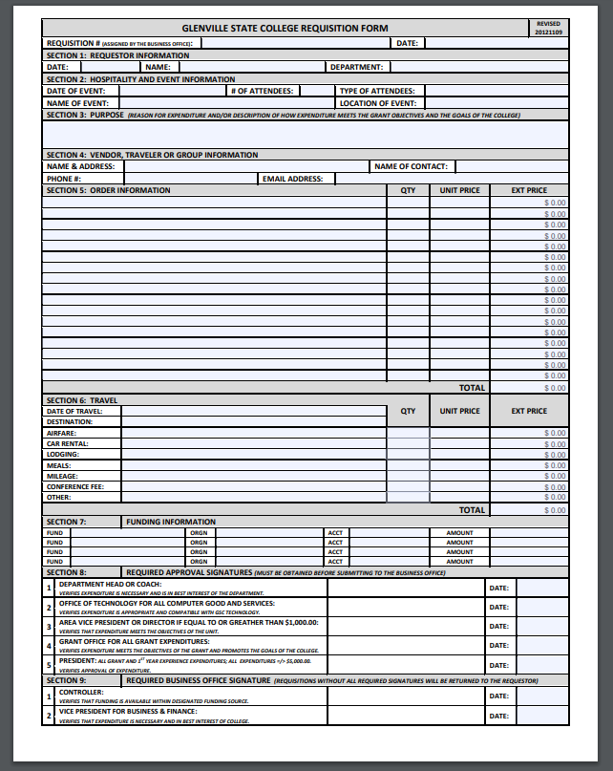
Purchase Requisitions

Slide 5
When is a Requisition required?
  A Requisition is required for all goods or services except for those listed below.
  College Postal Services & Supplies.
  College Print Shop Services less than $500.00.
  Fuel for Public Safety Vehicles, President’s Car, Shuttle Buses, College-Owned Vehicles enrolled in ARI, Non-ARI enrolled vehicles travelling locally where fuel is the only expense, and Small Equipment (mowers, blowers, etc…).
  Other exceptions are listed in the Business Office Operating Policies and Procedures but, do not generally pertain to most Units.
  The Department is responsible for preparing the Requisition and obtaining all of the required departmental signatures except for the President’s signature.

Slide 6
How do I Complete & Submit a Requisition?
Complete all applicable fields.
Provide a meaningful purpose.
Make sure the funding information is accurate (Sec. 7).
Make sure the purchase will be tax exempt.
Include Shipping, Handling, Payment Processing Fee or other charges.
Attach supporting documentation.
Obtain the required departmental signatures except the President’s signature.
Email to Requisition@glenville.edu

Slide 7
What type of Supporting Documentation is required for a Requisition?
A detailed shopping cart printout.
A copy of an invoice.
A registration form.
An estimate, proposal, quote, bid, agreement, contract…
Other types may be required or accepted.

Slide 8
How do I know when a Requisition is approved?
The Unit will receive a copy of the Requisition via email indicating if the Requisition is approved or not approved.
The Unit will work with the appropriate Business Office staff to resolve any issues until the Requisition is either approved or canceled.

Slide 9
When does a Requisition have to be revised?
If the dollar amount increases more than twenty-five (25) dollars for goods or services that are already listed on the Requisition.
The most common reason for revising a Requisition is shipping and handling.

Slide 10
How do I revise a Requisition?
Prepare a new Requisition, indicate the Requisition number and the Version number
or
Make the necessary changes on a copy of the previous version of the Requisition.
Process through the normal Requisition procedures.

Slide 11
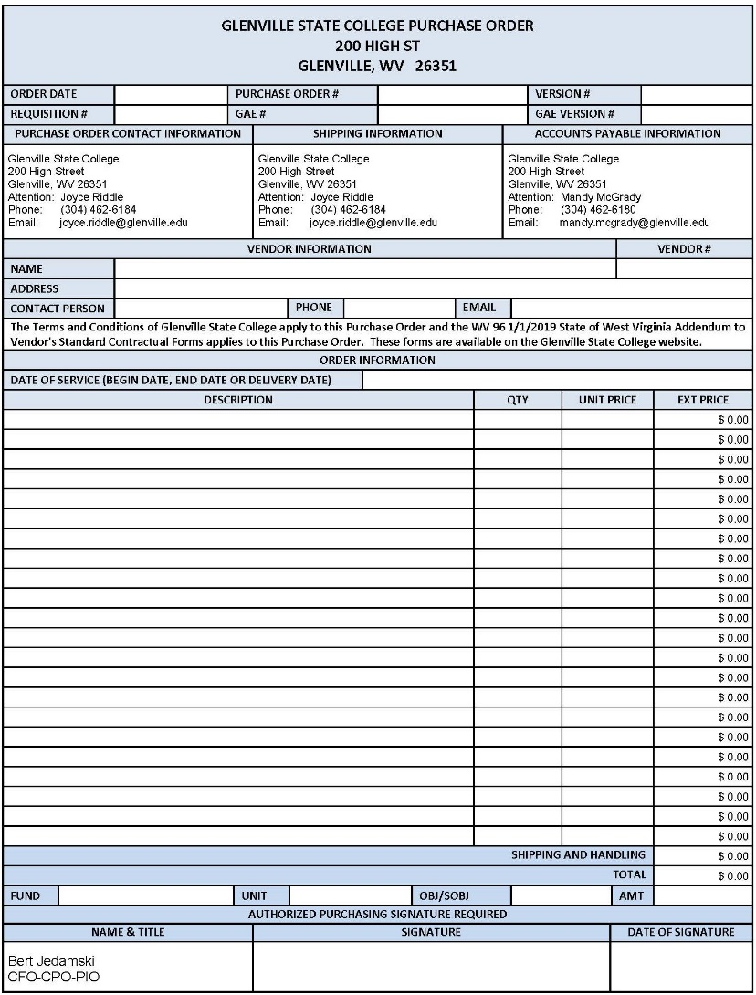
Purchase Orders & Change Orders

Slide 12
What is the purpose/benefit of a Purchase Order?
To formalize requirements and pricing.
To serve as a legally binding document.
To provide legal protection.
To incorporate terms, conditions, addendums, or other required or important documents.
To aid in budgeting and planning.
To aid in tracking expenses and payments.
To improve inventory management.
To create an audit trail.

Slide 13
When is a Purchase Order or a Change Order required?
A Purchase Order is required for all services prior to the begin date of service.
A Purchase Order is required for goods that cost $25,000.00 or more, singularly or in aggregate prior to placing the order.
A Change Order is required if there is any change to Purchase Order.

Slide 14
What Supporting Documentation is required for a Purchase Order?
The most common types of supporting documentation for a Purchase Order are listed below.
The College’s Terms & Conditions.
A Contract, Agreement, Bid, Quote, or Renewal form.
A “WV-96 Addendum to Vendor’s Standard Contractual Forms” form.
A Certificate of Liability Insurance.
A Purchasing Affidavit.
A copy of the vendor’s Contractor’s license.

Slide 15
What is the process if a Purchase Order is required?
After the receipt of an approved Requisition, the Purchasing Office will:
Resolve any vendor or documentation issues.
Issue the Purchase Order to the vendor to place the order. Supporting documentation will be included with the Purchase Order.
If a Purchase Order cannot be issued to the vendor to place the order, a Purchase Order for “accounting purposes only” will be issued internally.

Slide 16
What is the process if a Purchase Order is not required?
The Unit may place the order upon receipt of a Requisition that is approved by the Business and Finance Office. A Purchase Order for “Accounting Purposes Only” will accompany the Requisition.

Slide 17
Receiving
Receiving Cycle
Receive Goods
Add to Inventory
Add to Fixed Assets

Slide 18
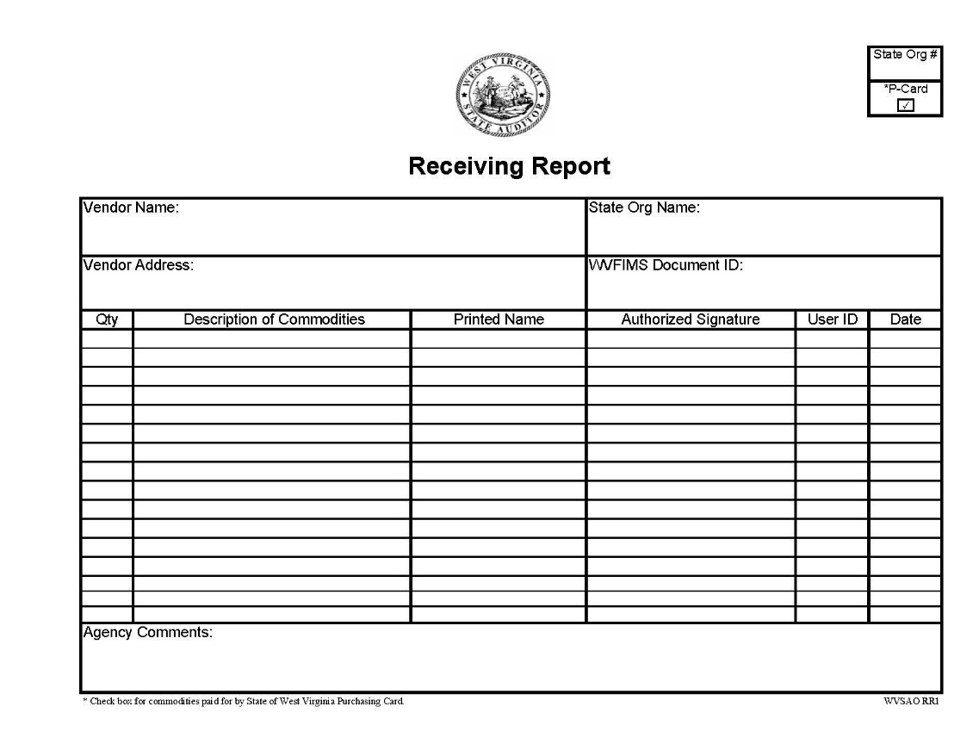
When is a Receiving Report required?
A Receiving Report is required for goods if the employee who processed the payment is not the same person who physically received the goods regardless of the payment method.

Slide 19
ACCOUNTS PAYABLE
Accounts Payable Cycle
INVOICE
MATCH DOCUMENTATION
PROCESS INVOICE FOR PAYMENT
RECONCILE PCARD STATEMENT
PAYMENT
(WVSAO)

Slide 20
Who Orders? Who Pays?
Purchase Order Issued to the Vendor to place Order
Purchasing Orders.
Accounts Payable pays.
Purchase Order Issued Internally for Accounting Purposes Only
Unit Pays.
Purchase Order Not Required
Generally for goods or services received prior to the issuance of a Purchase Order.
Unit Pays after the receipt of a Requisition approved by the Business Office.
Generally for goods.
For goods & services.

Slide 21
Who Orders? Who Pays?
If a Purchase Order was issued by the Purchasing Office to place the order, the Accounts Payable Office will process the invoice for payment.
If a Purchase Order was not issued by the Purchasing Office to place the order, the College Unit’s Purchasing Card Cardholder may place and/or pay for the goods or services upon receipt of a Purchase Requisition approved by the Business Office.
The Accounts Payable Office may process orders and/or payments on behalf of the Unit if the Unit’s Purchasing Card Cardholder cannot process the order and/or the payment due to card limit restrictions, the vendor requires a check, or other reasons.

Slide 22
What documentation does Accounts Payable require?
A copy of the Purchase Order, Change Order, and/or Requisition.
An Invoice approved by the Department Head.
A Receiving Report for goods.
A Hospitality Guest List.
A W9-if the vendor is not already in the Accounts Payable system.

Slide 23
What is the Approval Process for Invoices?
If initially received by the Accounts Payable Clerk, the Accounts Payable Clerk will email the document to the Department Head for approval within five (5) business days. The Department Head must print the document, sign on the approval stamp `and return it to the Accounts Payable Clerk within five (5) business days.
If initially received by the Department, the Department Head must place the approval stamp on the document, sign the approval stamp and submit the document to the Accounts Payable Clerk within five (5) business days.
If payment is not approved by the Department Head, which may be for reasons such as, but not limited to, goods or services not received or not satisfactorily received, item(s) must be returned or incorrect quantity or price, the Department Head must provide an explanation, address the issues that prevent payment, obtain new documentation if necessary and notify the Accounts Payable Clerk if payment is subsequently approved or canceled.

Slide 24
What is the Processing Time for Payment of Invoices?
The Accounts Payable Clerk will process all Invoices, Bills, Employee Reimbursements or Travel Expense Settlements for payment within ten (10) business days of receipt if there are no issues preventing payment.

Slide 25
TRAVEL
TRAVEL CYCLE
REQUISITION
TRAVEL EXPENSE SETTLEMENT FORM
ACCOUNTS PAYABLE
PAYMENT
(WVSAO)

Slide 26
How do I get reimbursed for my Travel Expenses?
Complete the Travel Expense Account Settlement (TES) form.
Attach a copy of the supporting documentation.
Submit the TES and supporting documentation to Accounts Payable.
The reimbursement of any travel expense is limited to the actual cost of the travel expense except for mileage. Mileage reimbursement will be based on the number of actual miles traveled.

Slide 27
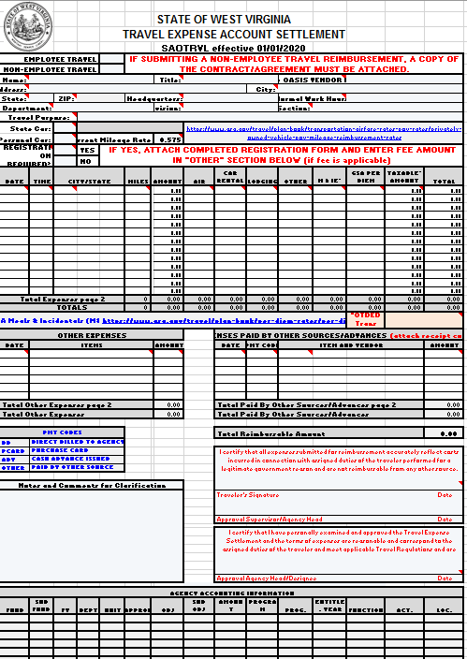
How do I complete the TES?
One page only (unless necessary).
Contact Accts Payable for your Oasis vendor number. The traveler’s name and address on the form must match the traveler’s Oasis vendor information.
Complete all fields at the top of the form.
All Expenses must be recorded in the top part of the form (no matter how it was paid).
Anything listed in the “Other” column must also be listed in the “Other Expenses” section in the middle of the form.
All expenses paid by PCard or other sources (Foundation or outside organization) must be listed in the “Expenses Paid by Other Sources” section.
The Traveler and Supervisor Signature must be on the form before it is sent to Accts Payable.

Slide 28
What supporting documentation is required for Travel?
A copy of the approved Requisition.
An itemized receipt for EACH expense except mileage reimbursement.
The traveler’s name MUST be on all hotel, rental car and registration invoices or receipts.

Slide 29
When are Travel Expense Account Settlements Due?
Must be submitted to Accounts Payable within seven (7) calendar days after the last date of travel.
Must be submitted through Oasis within fifteen (15) calendar days after the last date of travel.

Slide 30
Purchasing Card (Pcard)
PCARD CYCLE
REQUISITION
PAYMENT
(record transaction on log sheet)
RECONCILIATION
LOGSHEET
(submit to supervisor)
Notes:
This shows the cycle for becoming a purchasing card holder - we’ll break each of these components down for you…

Slide 31
How do I get a Pcard?
Complete a Pcard Request form and submit it to the Purchasing Card Coordinator.
Create a MyApps Account at www.wvsao.gov.
The Pcard Coordinator will inform you if the application was approved and set up the online training modules.
Complete the on-line Cardholder and Ethics training. This training must be complete annually.
Electronically sign the cardholder agreement.
Complete the College’s one-on-one training.

Slide 32
What are my Responsibilities & Duties?
Read, follow and understand the College’s Business Office Operating Policies and Procedures, the West Virginia State Auditor’s Office Purchasing Card Policies and Procedures, and the West Virginia Ethics Commissions Policies and Procedures.
Keep your Pcard and Pcard information secure.
Place and/or pay for orders for your unit only.
Collect and scan all supporting documentation for each transaction.
Reconcile each transaction in Oasis and attach a scan of the supporting documentation to each transaction in Oasis in a timely manner – meeting all deadlines.
Log each transaction onto the monthly log sheet and submit the log sheet with your credit card statement to the Purchasing Card Coordinator at the end of the month.
Correct any errors or Resolve any issues related to the transaction.

Slide 33
IMPORTANT REMINDERS!!
Turn in Requisitions before making transactions.
NEVER use the card for personal purchases
Pcard delegation is prohibited
Do not allow a vendor to charge WV state tax
Do not allow vendors to automatically charge your card each month (Auto-pay).
Stringing is prohibited!
All travel related pcard transactions require a completed TES to be attached in Oasis.
Convenience Fees must be a flat rate. The transaction must be a non-face-to-face transaction.
Check out fees or surcharges must be 4% or less.
No gift cards for prizes – only Musket Bucks or B&N Campus Store certificates are allowed. A “gift card request form” and “prize award sheet” is required.
Avoid 3rd Party Vendors if possible (Amazon Marketplace – Paypal etc.)

Slide 34
What are the Pcard Deadlines?
All transactions should be reconciled within 10 days of the transaction date.
The Billing Cycle Ends on the 15th of every month (or the next business day after a weekend or holiday).
All transactions must be reconciled by the 22nd of each month so the master statement can be paid.
Log sheets and statements must be submitted to supervisors with enough time to forward to the Pcard Coordinator by the last business day of the month (around the 30th).

Slide 35
How do I reconcile my Pcard in Oasis?
Go to the PRCUU table in Oasis.
Attach the supporting documentation first – then save.
Update the “Receipt Date” so it matches the actual receipt – then save.
Add descriptive comments and modify the commodity code – then save.
Check the Unit of Measurement and Price per Unit section.
Enter Fund Accounting info and Object Codes, and add the Detail Accounting Code – then save.
Change the status to “Reconciled” – then save.
(See Oasis for other status options)

Slide 36
What is the Pcard Documentation?
Approved Purchase Requisition and the Purchase Order.
Backup Documentation – invoices, receipts, etc.
Receiving Report if applicable
Hospitality Form if goods are food related and section 2 of the requisition is incomplete
Prize award sheet if applicable
Gift card request form and Prize award sheet
Student Activities require a sign-in sheet – unless it is an “open house” event
Travel related transactions require a signed TES
Please attach prior to the 22nd of the month!

Slide 37
Purchasing Card (Pcard)
Documentation
Examples

Slide 38
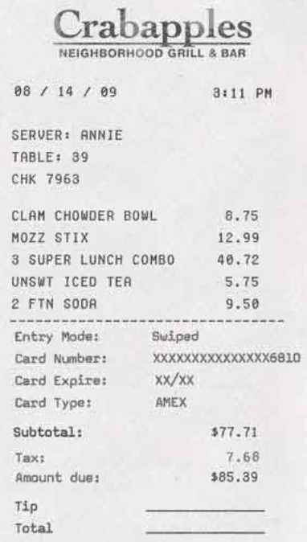
Documentation - Receipts
Every transaction requires proper documentation.
Valid Receipts:
are legible
descriptive (misc. or generic names are not allowed)
contain vendor info. (you can write it on the rcpt)

Slide 39
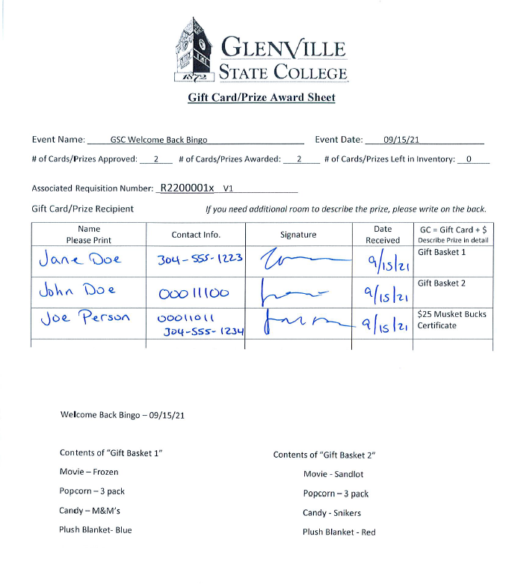
Prize Request/Award Sample

Slide 40
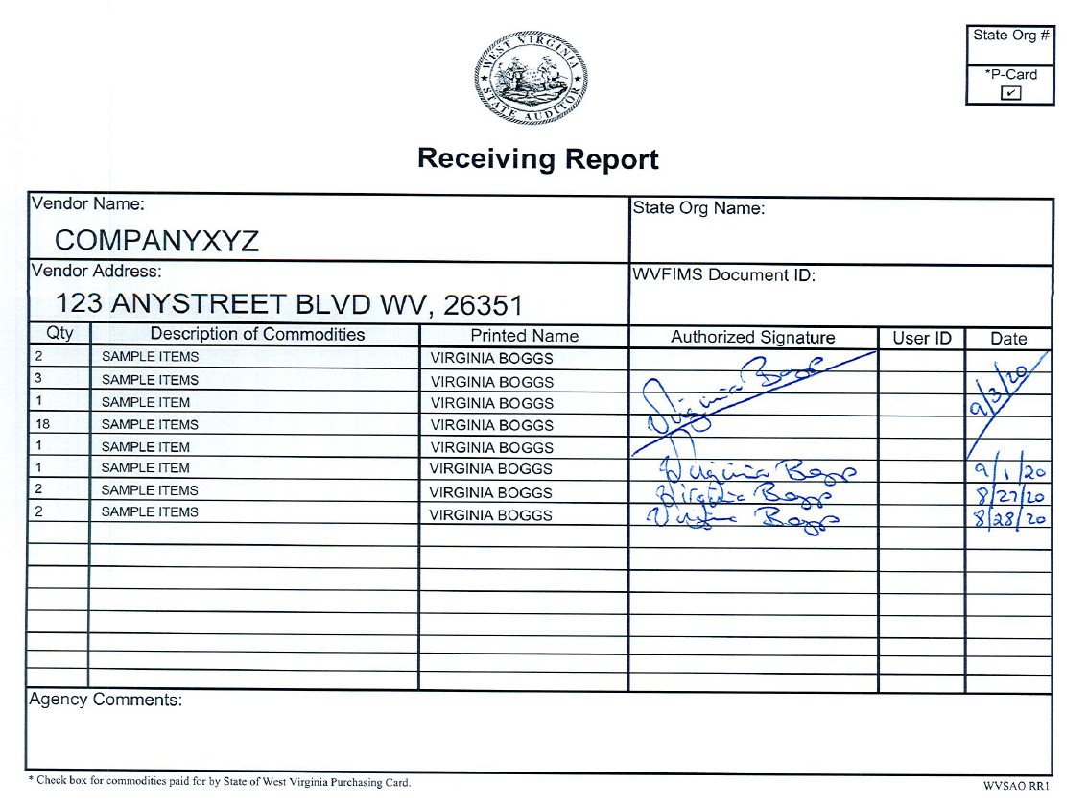
Receiving Report Sample

Slide 41
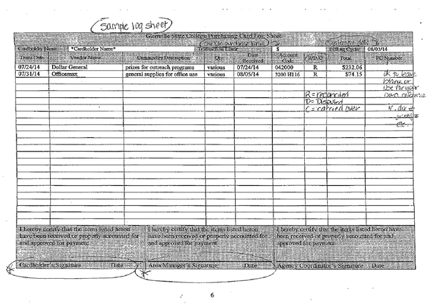
Log Sheet Sample
Log into your USBank Account to to view and print your monthly statements. Statements and log sheets are required on the last business day of the month!

Slide 42
Purchasing Card (Pcard)
Oasis Example

Slide 43
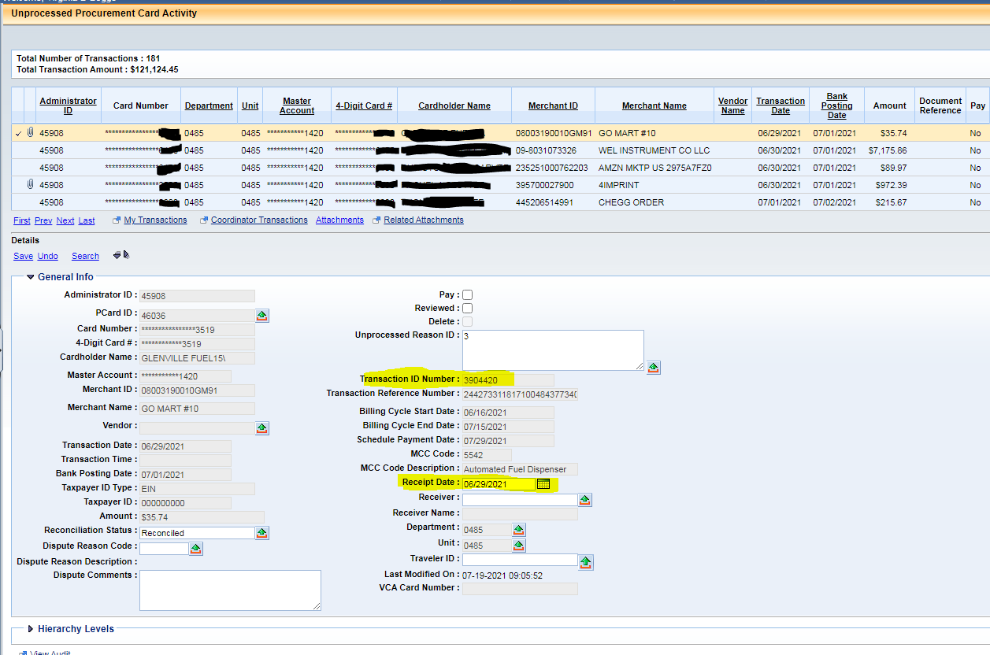
OASIS – TOP SECTION

Slide 44
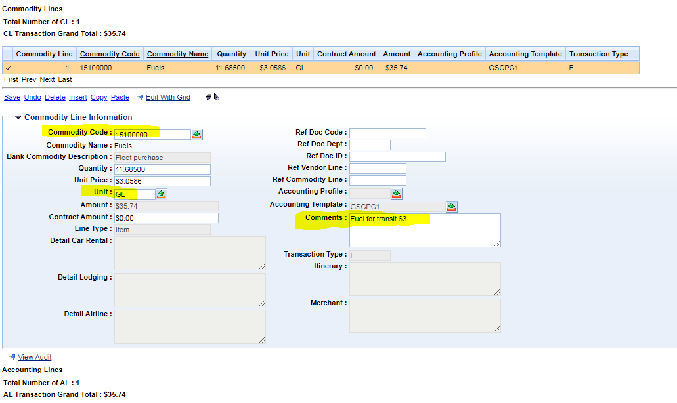
OASIS – MIDDLE SECTION

Slide 45
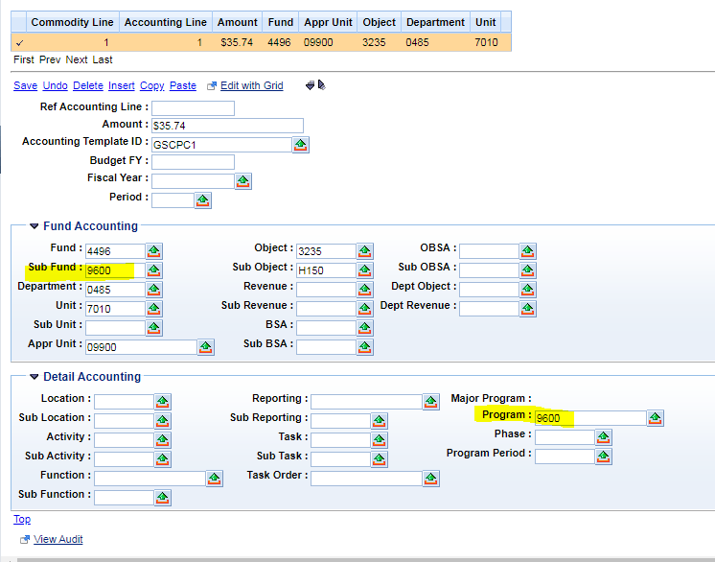
OASIS – BOTTOM SECTION

Slide 46
Frequently Asked Questions
What do I do if I see a transaction in Oasis that I didn’t make? – First contact the number on the back of your card and notify the Fraud Department. Secondly, contact the Pcard Coordinator for further instructions.
What do I do if I accidentally used my Pcard for a personal purchase? – Try to rectify the transaction at the point-of sale by getting a refund. Contact the Pcard Coordinator and type up a memo or email explaining what happened & how you corrected it. A Self-Report memo/email will be sent to the Auditor’s Office. If the charge could not be credited, the amount will be paid back to the college and a copy of the deposit slip attached to the transaction in Oasis.
What do I do if I need to Dispute a charge. – First contact the vendor and try to resolve the matter with Customer Support. If it cannot be resolved, then contact the Pcard Coordinator for further instructions.
What if I need to purchase something that is more than my currents spending limits would allow. – Have your supervisor or Area Vice President send an email to the Pcard Coordinator explaining the limit increases and when the amount should revert back. Allow for one to two days for the change.

Slide 47
QUESTIONS

