Slide 1

Procurement Software: Precoro
Finance and Administration

Slide 2

What is Precoro?
Precoro is Glenville State University’s procurement and spend‑management system. It allows you to:
  Create purchase requests for goods and services
  Route requests for internal approval
  Confirm receipt of items
  Track order status from start to finish
  Review and analyze departmental spending
  Accurate Budget Tracking
**Your access in Precoro is based on the roles and permissions assigned to you by your department.
These roles determine what you can view, create, approve, or manage within the system.
If you ever need additional access or believe something is missing, please contact the Finance and Administration Office so we can update your permissions.

Slide 3
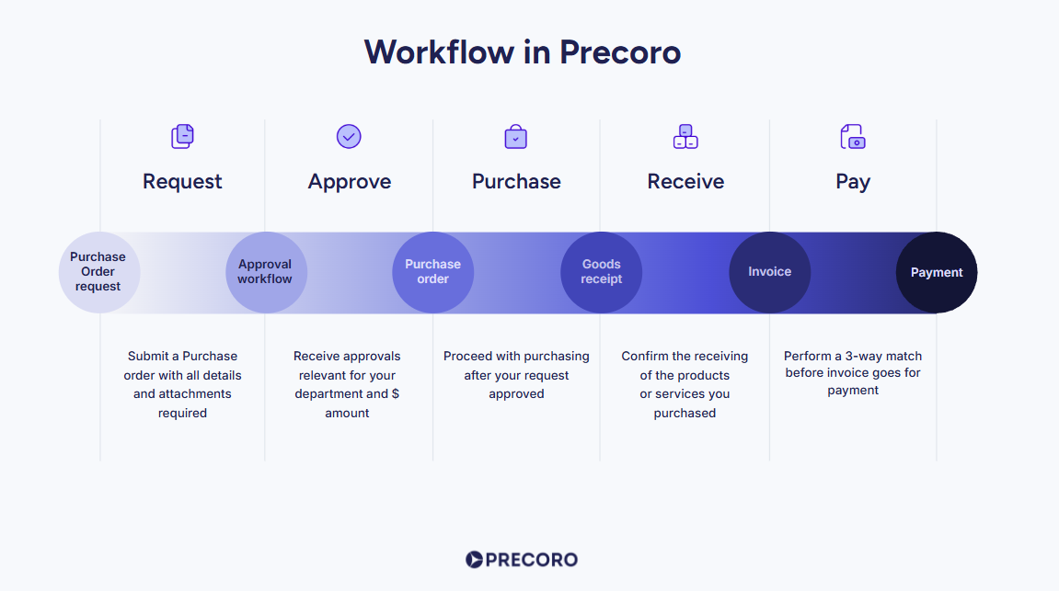
Workflow

Slide 4
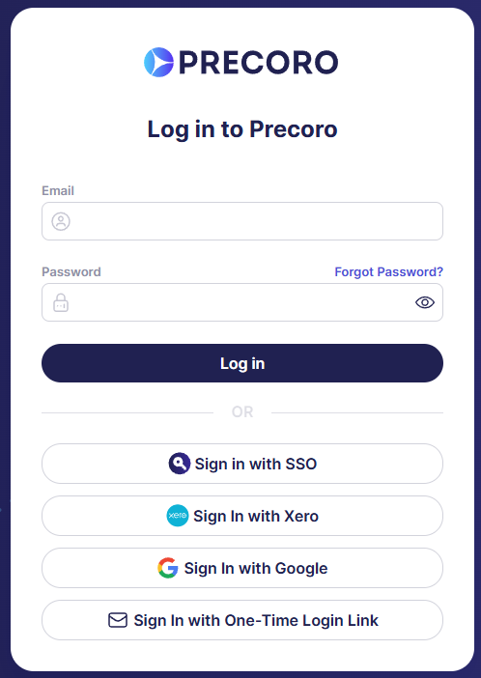
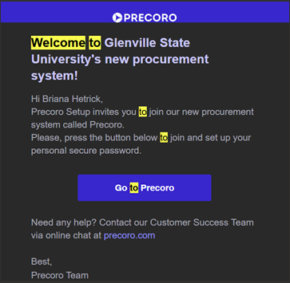
How to Log-in
You will be invited to join the system via email from no-reply@precoro.com.
Open the email → Go to Precoro → Create your password
Next time you are trying to login go to app.precoro.com and login via Single Sign On.
Please reach out to the Finance and Administration Office if you can’t find the invite or can’t log in.

Slide 5
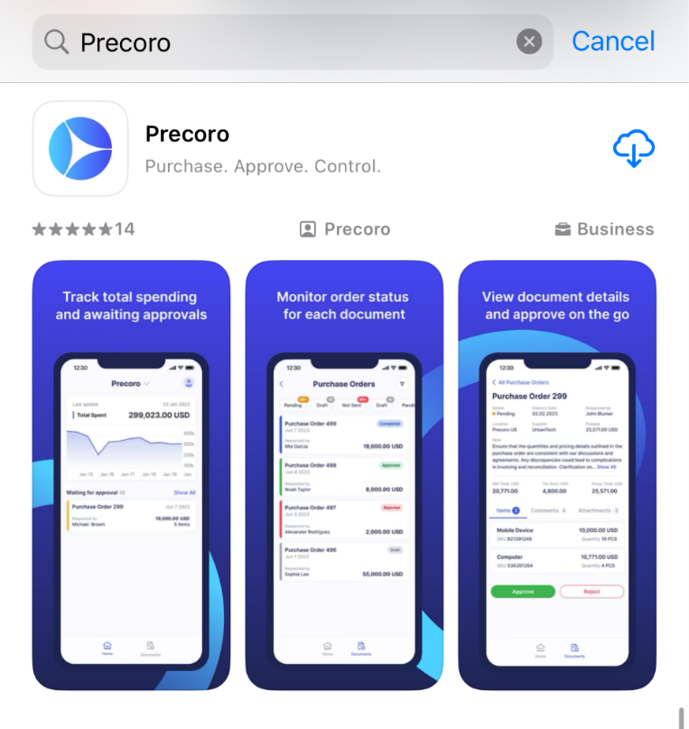
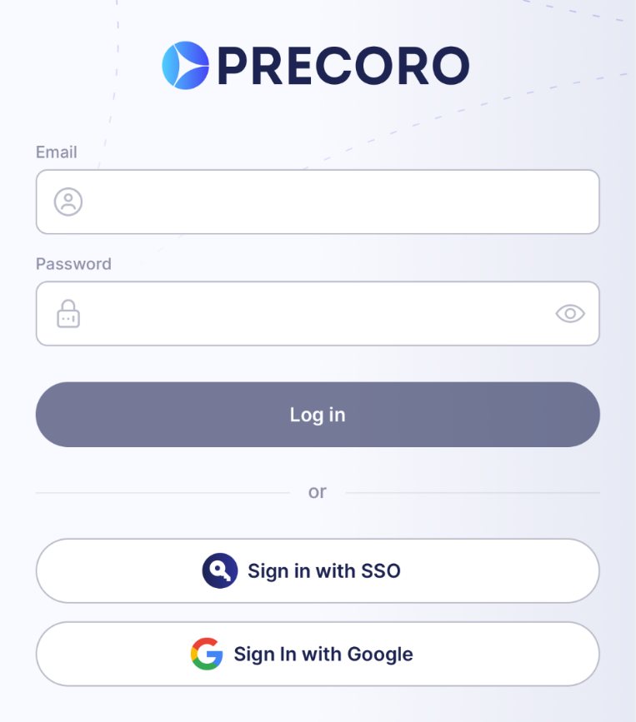


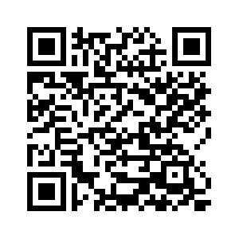
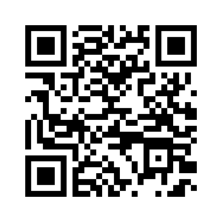
Precoro Mobile App
Download the Precoro app from the App Store or Google Play.
The Precoro app will allow you to:
Create PRs and Receipts on the go
Receive instant push notifications about documents that require approval
View document info and approve with just a click
Stay updated on each request status from start to finish
Add, edit, and delete comments on documents

Slide 6
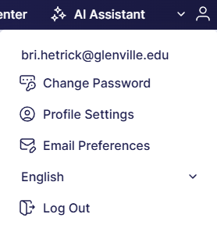
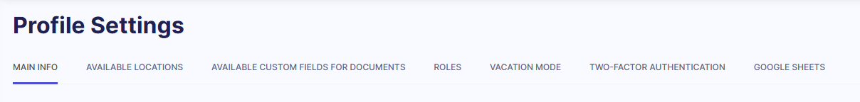
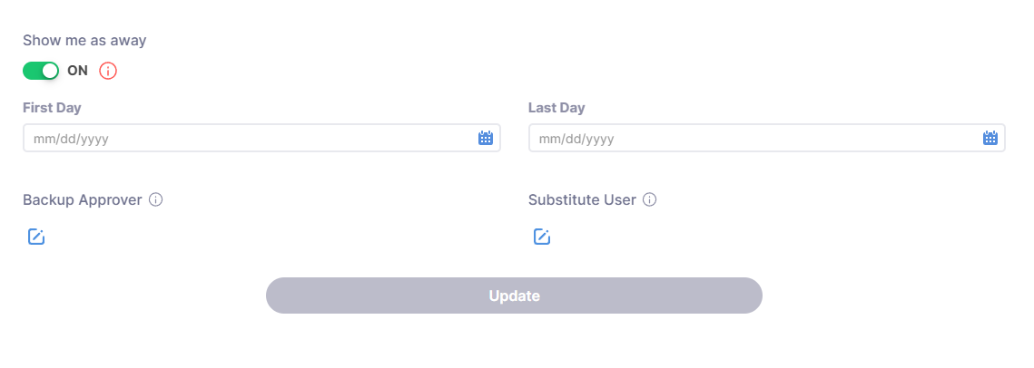
User’s Profile & Vacation Mode
You can manage your profile using the settings under your email address. When you click the small arrow on the right side you can see several sections:
Profile settings -> to check the main info about your user roles and access or turn on vacation mode when you’re out of the office.
Make sure to select your back-up approver or substitute users who can take care of your action items while you’re unavailable. The detailed instruction on how to set it up is here.
Email Preferences - to specify which notifications you’d like to receive.

Slide 7
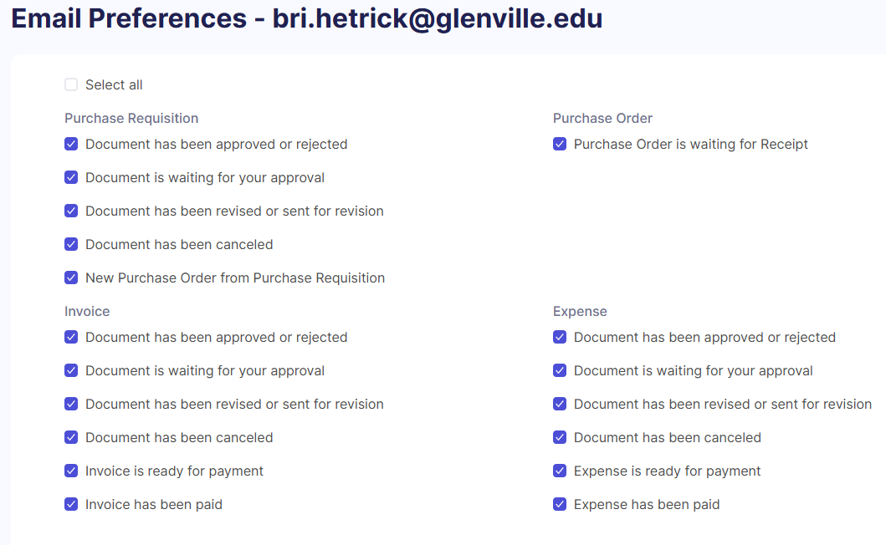
Email Preferences
Precoro sends email notifications so you don’t miss important tasks - like approving documents or replying to comments from colleagues.
Notifications are grouped by document type and are tailored to your role and access level in Precoro.
You can customize which notifications you receive in the Email Preferences section of your profile.

Slide 8
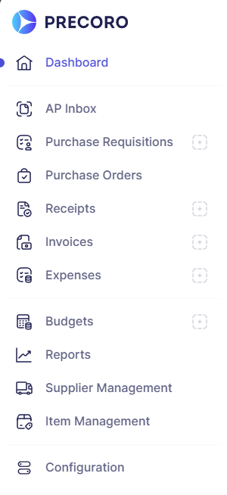
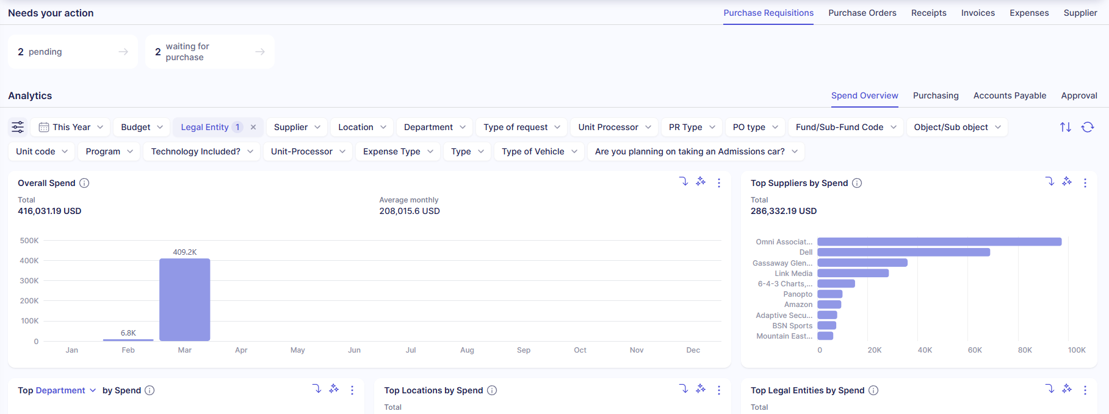
General Dashboard
The Dashboard page will help you quickly and efficiently obtain the latest information and proceed to necessary action. Use the Dashboard page to:
Promptly view a breakdown of essential information.
See all the actions required from you, and by clicking on the Action Card, get redirected to the necessary page.
Receive information from pre-configured graphs and spending charts by:
  Overall spending, Supplier’s gross total, custom fields for items and documents
Number of Accounts Payable Transactions (invoices marked as paid).

Slide 9
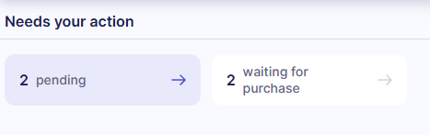
Action Cards
Precoro uses Action Cards to highlight necessary actions needed from the user by module. The action cards appear on the top portion of the Dashboard, and in the document summary lists in Precoro modules.
Use the action cards above the graphs to see all the actions required by the individual within a certain document type.
You can switch between various document types (i.e. PR, PO, Invoices) by clicking on their corresponding name.
Selecting the necessary document tab and clicking on the action card will redirect you to the needed page and will filter out the documents accordingly.
For example: when you click on “Draft” action card within Purchase Requisitions, Precoro will filter out all your PRs that haven’t yet been submitted.

Slide 10
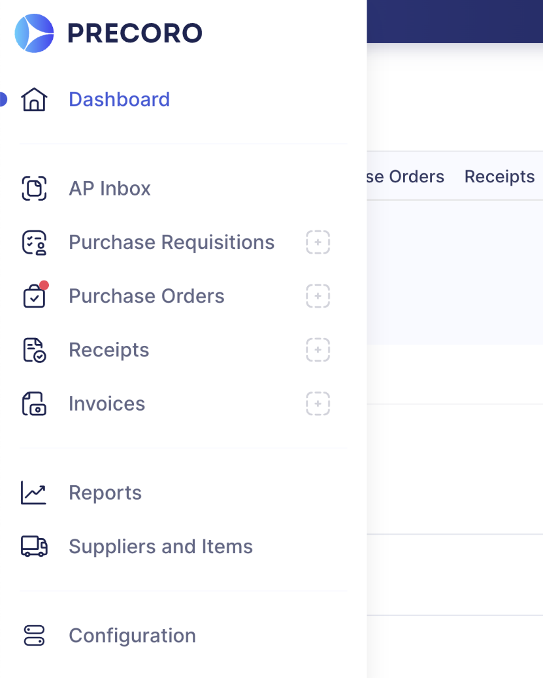
Side Panel Navigation
Use the left-side panel to navigate between different modules of the system.
The red dot • on the module icon implies that you have some actions to perform within a module: for example, approve a document or create a Purchase Order from the approved Purchase Requisition.
Near the name of the module you can find the dotted box button. Clicking on this button will allow you to initiate a new document within the selected module.

Slide 11
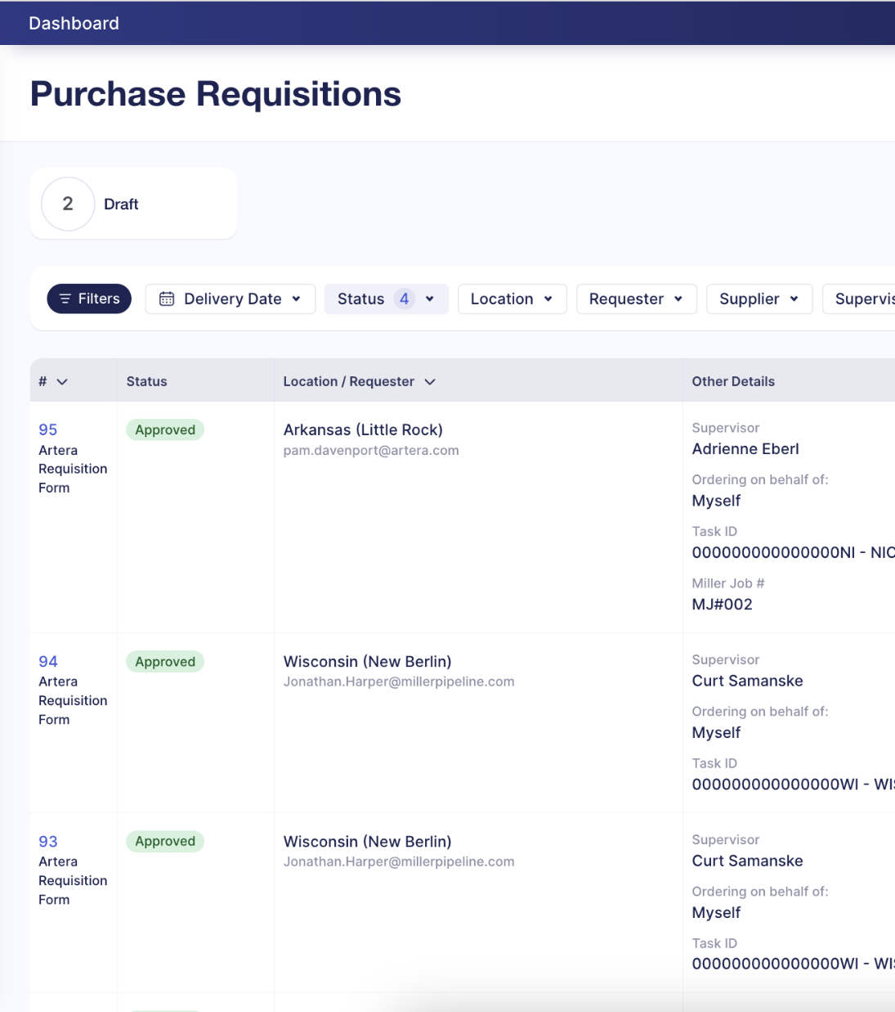
Document Summary List
When you select a Precoro module from the side navigation bar, the system will open up to a document summary list. This page will provide a summary of all documents within the selected module & highlight their current status.
Draft - the document has not been released yet.
Pending - the document is awaiting approval.
Approved - the document has been approved and released.
Rejected - the document was denied.
There are other statuses that can be unique per each document type.
In each document summary list you can see a set of action cards relevant to you within the selected module.

Slide 12
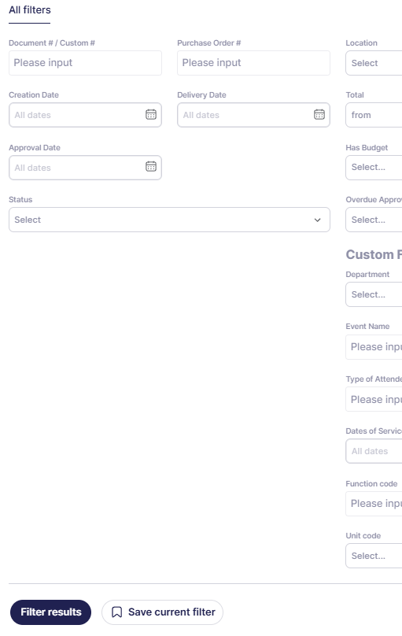
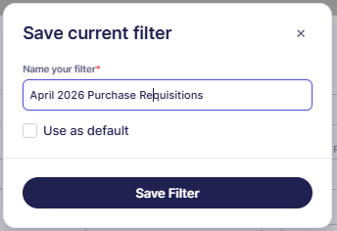

Advanced Filters- Document Summary
Filters can be used to narrow down document search criteria and are located at the top of each dashboard page:
Advanced filters – click on to see all available search criteria. Through here, you can select all needed search criteria and apply them by clicking on Filter results .
**You can also Save current filter and use it as default, so that every time you log in to Precoro, you see the relevant information.

Slide 13
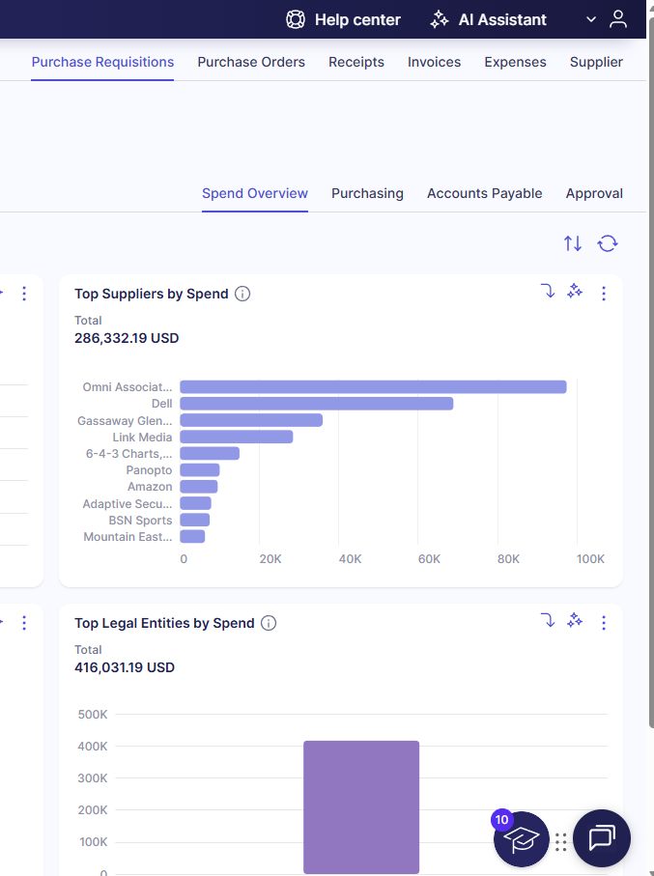
Precoro Support Team
Precoro knowledge base (tutorial articles).
You can easily access it from your Precoro profile using the ‘Help Center’ button.
Chat in-app (on the right side at the bottom).
Contact our Support team via email: support@precoro.com
Contact your admins:
Finance & Administration Office

Slide 14
Glenville State University Policy Changes

Slide 15
Updated Changes
A Purchase Requisition will have to be completed for EVERY single purchase regardless of amount
  This ensures accurate budget tracking and reporting within Precoro
The President’s signature will not be required unless over $50,000
  Precoro will automatically trigger Dr. Manchin’s signature at this level
Print Shop/Post Office will require a requisition
  These purchases may be entered into Precoro after the fact or monthly if preferred. However, all such expenses must still be recorded in the system
Supporting documentation is mandatory for all purchases
  In rare cases where documentation is unavailable, a Word document explaining the reason of why must be uploaded instead. Precoro will not allow you to submit a requisition without an attachment.

Slide 16
Updated Changes
Requestors will not be allowed to create a purchase requisition that exceeds their budget. This control is in place to prevent overspending and ensure financial discipline
  If there is a need to exceed the budget requestors must complete an Over-Budget Purchase Justification Form, which can be found on GSU’s webpage under Business & Finance forms
For emergency purchase you must contact the Chief Financial Officer before any purchases are made to get prior approval. A purchase requisition must be submitted within 5 days of the emergency.
If a change in funding information is needed for a completed purchase requisition, please do not update the document in Precoro yourself. Please contact the Accounting & Reporting Manager and they will make the necessary updates in both Precoro and Oasis.
Requestors will have the ability to request new suppliers through Precoro and these requests will be sent to the Director of Purchasing.
  If the supplier is registered with the state, the Purchasing Director will approve the request
  If the supplier is not already registered, the Purchasing Director will contact the supplier to collect all required documentation and complete registration. Please allow time for this to be processed.

Slide 17
Purchase Requisitions

Slide 18

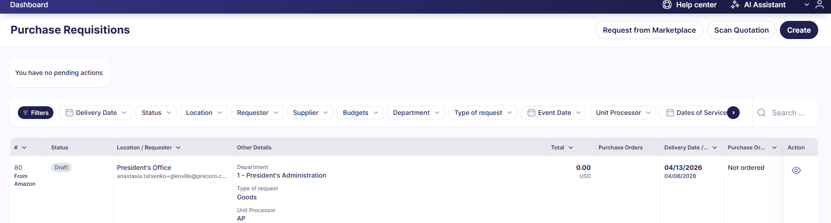
Purchase Requisition Creation
How to Create a Purchase Requisition :
From the left-side menu, open the Purchase Requisitions module.
Once the module is open, click on the button.
This action will bring you to the PR form you have to fill out prior to submitting the document for further processing.

Slide 19
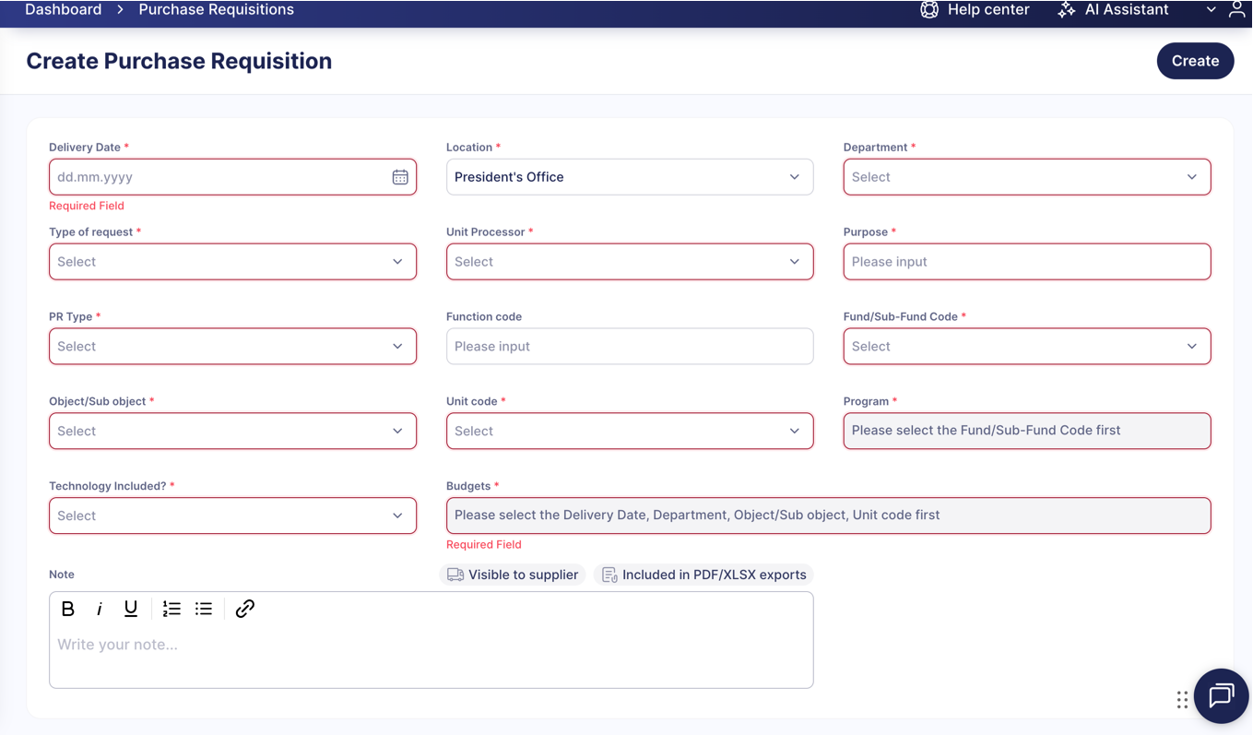
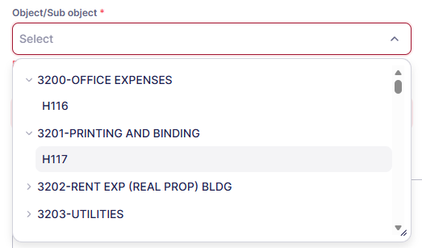
Purchase Requisition Header Information
In the PR form, you will see a number of fields to fill out.
Required fields are marked with red asterisks - *
Delivery Date is when you expect the order to be in, if unknown just put a week out.
Matching Pairs for Fund/Sub-Fund and Object/Sub-Object have already been added into a dropdown list for convenience

Slide 20
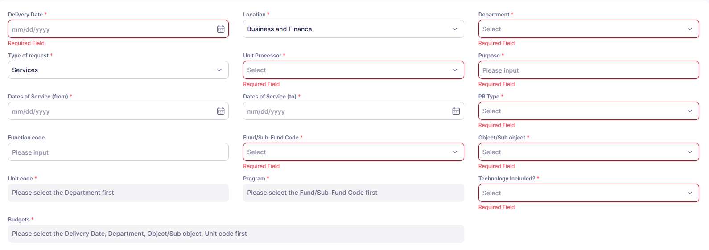
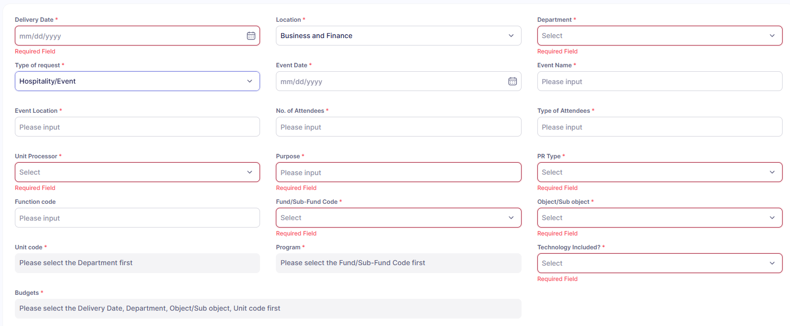
Purchase Requisition Header Information
On the purchase requisition header, the fields will change depending on the type of request
Goods
  Standard header
Services
  Standard header and will include Dates of Service fields
Hospitality/Event
  Standard header and will include fields for event details

Slide 21
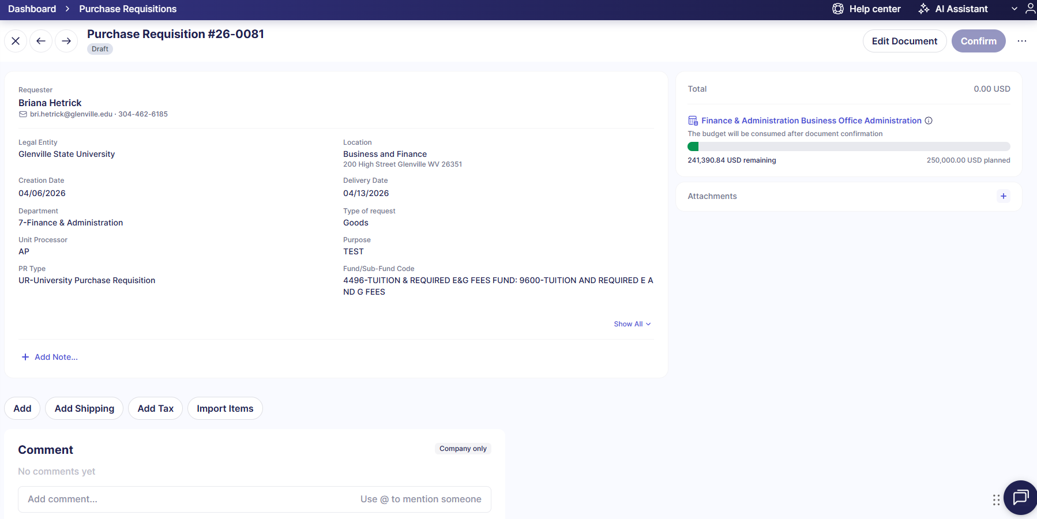
Adding Items to the Requisition
The system will assign the Purchase Requisition number, which can be used to find the Purchase Requisition at a later date.
You will now be able to add the following items to the Purchase Requisition:
Line items for purchase
Attachments (i.e. Supplier quotes)
Notes (prints on all documents)
Comments (for University view only)

Slide 22
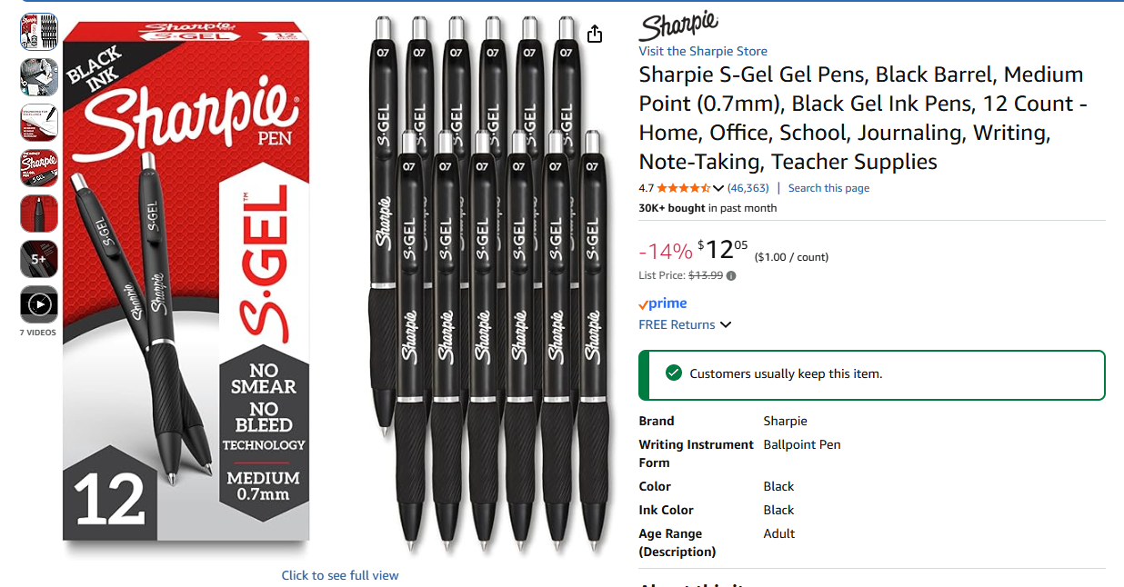


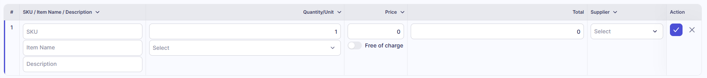
Adding an Item to the Requisition
To add line items: Click button and input items manually
Example: If you wanted to order a 12 pack of pens off Amazon you would need to add a line, fill in Item Name, Description, Quantity, Price and Supplier. Be sure to hit the button to save your line item.

Slide 23
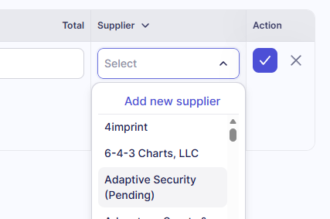
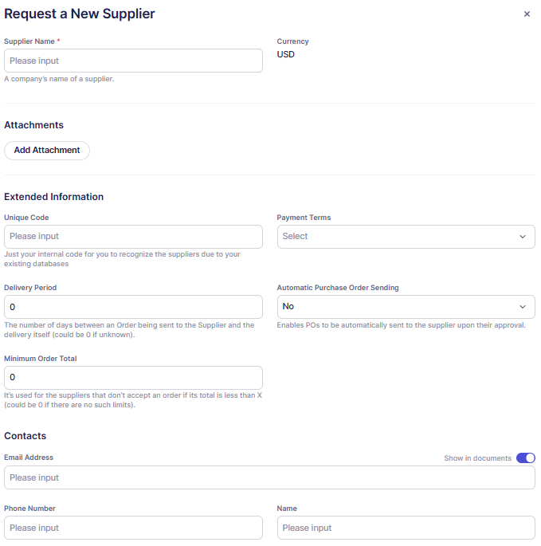
Requesting a New Supplier
Many suppliers have already been inputted into Precoro. If a supplier you need is not listed you will need to add a new supplier.
To Request a New Supplier:
Open the dropdown under suppliers and select “Add New Supplier”
A popup window will appear, Fill out Supplier’s Name (Required)
Fill out any contact information if possible
Scroll to the bottom and hit the “Request” Button
*There are tons of boxes that can be completed but are not required.

Slide 24
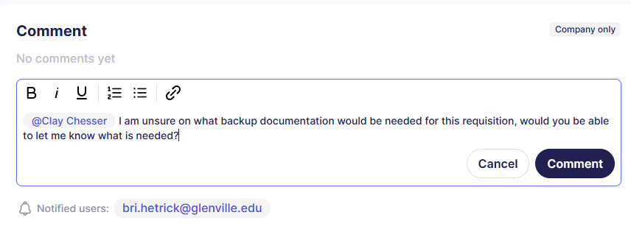
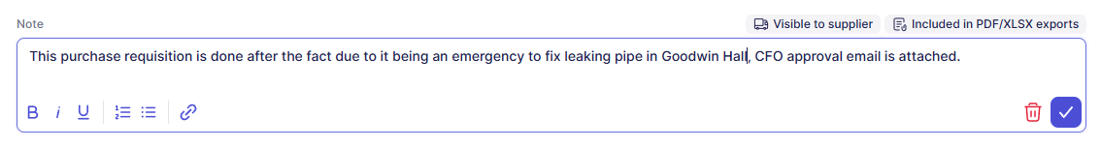
Notes and Comments
If you want to add a Note or a Comment to the Purchase Requisition, you can type those in the respective boxes.
Be mindful of the differences between these two fields.
Note captures information that is necessary for both internal and external parties. Information left in this box is visible by all and prints on all Precoro documents, including the Supplier purchase order.
Comment captures information that is viewable by only Glenville users and does not print on any documents.
Tip: Utilizing the “@ + Name” feature will tag a recipient and provide an e-mailed copy of the Comment. This is a good way to ensure the recipient receives the comment.

Slide 25
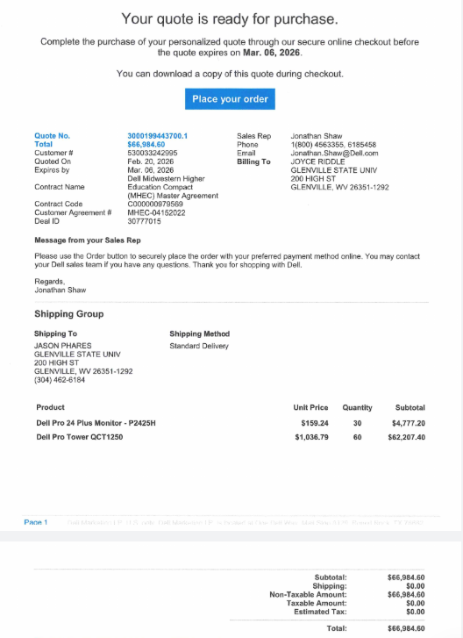

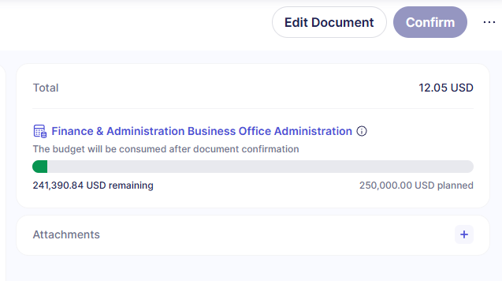
Attachments
To add an attachment, click on the button in the Attachment box. This will bring you to your computer files from which you can select the related attachments to add.
Supporting documentation is mandatory for all purchases and Precoro will not let you continue to the next step until an attachment has been added.
Supporting documentation can be but not limited to a detailed shopping cart printout, invoice, registration form, estimate, proposal, quote, agreement, contract or other itemized vendor documentation.

Slide 26
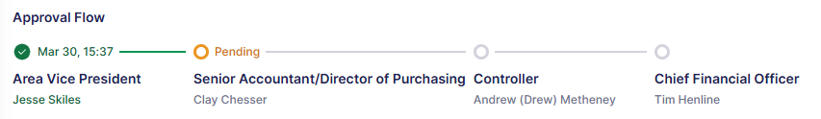
Review and Finalize the Requisition
Once you have finished adding all the needed items into the Purchase Requisition, please review & confirm the document. Ask yourself:
Does the Item Name reflect what you need?
Is the Qty correct?
Is the pricing correct?
Is the Supplier name correct
Did I include Backup Documentation?
If you wish to edit or delete a line item from the PR, scroll to the Edit column and select the appropriate action: edit or delete the item. If no changes are needed hit confirm in the top right corner to release the document for approvals. The document will show where in the approval stage it is.

Slide 27
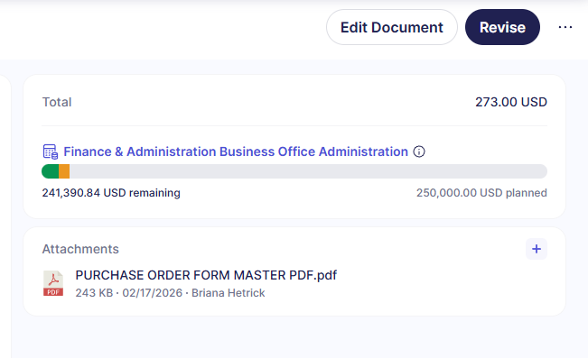
Editing the Purchase Requisition
In case some changes are required in the header information to your document, you can edit the Purchase Requisition header information by clicking Edit Document in the top-right corner.
Revise button is to edit the Items.
Once all changes are implemented, scroll to the bottom of the form and click Save.
NOTE:
All the changes will be logged in Revision history.
If you edit the header fields like Location, Department while the document is in Draft, Pending or In Revision statuses, these changes may affect the approval flow.

Slide 28

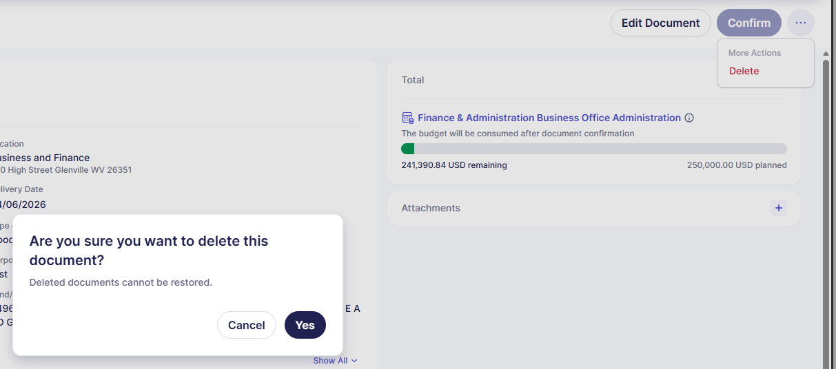
Deleting the Purchase Requisition
If the Purchase Requisition you started is no longer relevant, click the button and delete to remove it’s record from the system.
A confirmation box will appear, asking if you are sure you want to delete the document. Click Yes , or Cancel if you reconsidered.
Please note that you can delete only the documents that are in the Draft status. Other documents can be cancelled.
Note: Once deleted, you will no longer be able to view or retrieve the document.

Slide 29
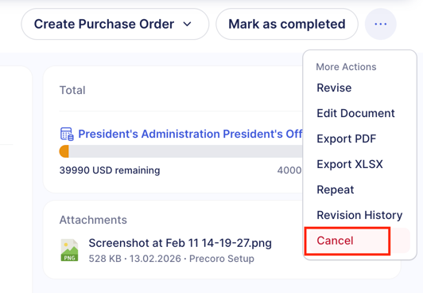
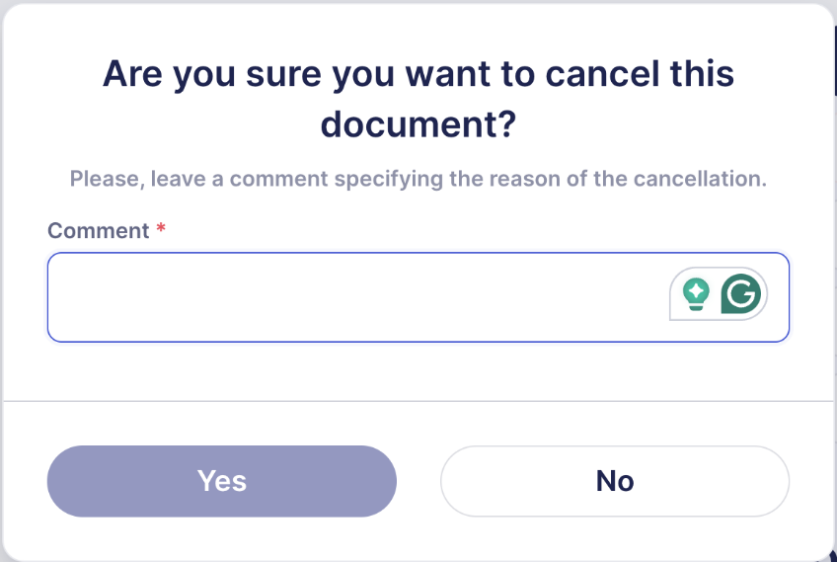
Cancelling the Purchase Requisition
If your Purchase Requisition has been approved but a Purchase Order was not created against it, or has been sent back for a revision, the Purchase Requisition can be cancelled.
To cancel your requisition, click Cancel.
A confirmation box will appear, asking if you are sure you want to cancel the document. Provide a comment, indicate why you are cancelling the document. Click Yes , or Cancel if you reconsidered.
NOTE: You can cancel the PR only before a Purchase Order has been created from it.

Slide 30
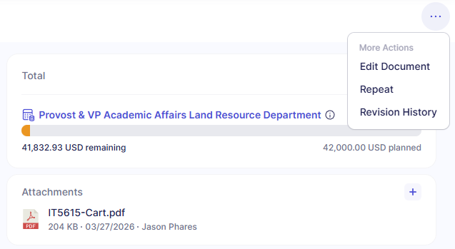
Duplicating the Purchase Requisition
If you have a Purchase Requisition that is in the Pending , Approved , or Completed status, the Purchase Requisition can be “copied” or “duplicated”. Using this functionality, the Purchase Requisition header information and line items will carry over into a new Purchase Requisition.
To duplicate a requisition, click Repeat.
You will need to enter a new Delivery Date
on the header form screen.
Click on Create to generate a new Purchase
Requisition with a new PR number.
If no other changes are needed, click
Confirm.

Slide 31
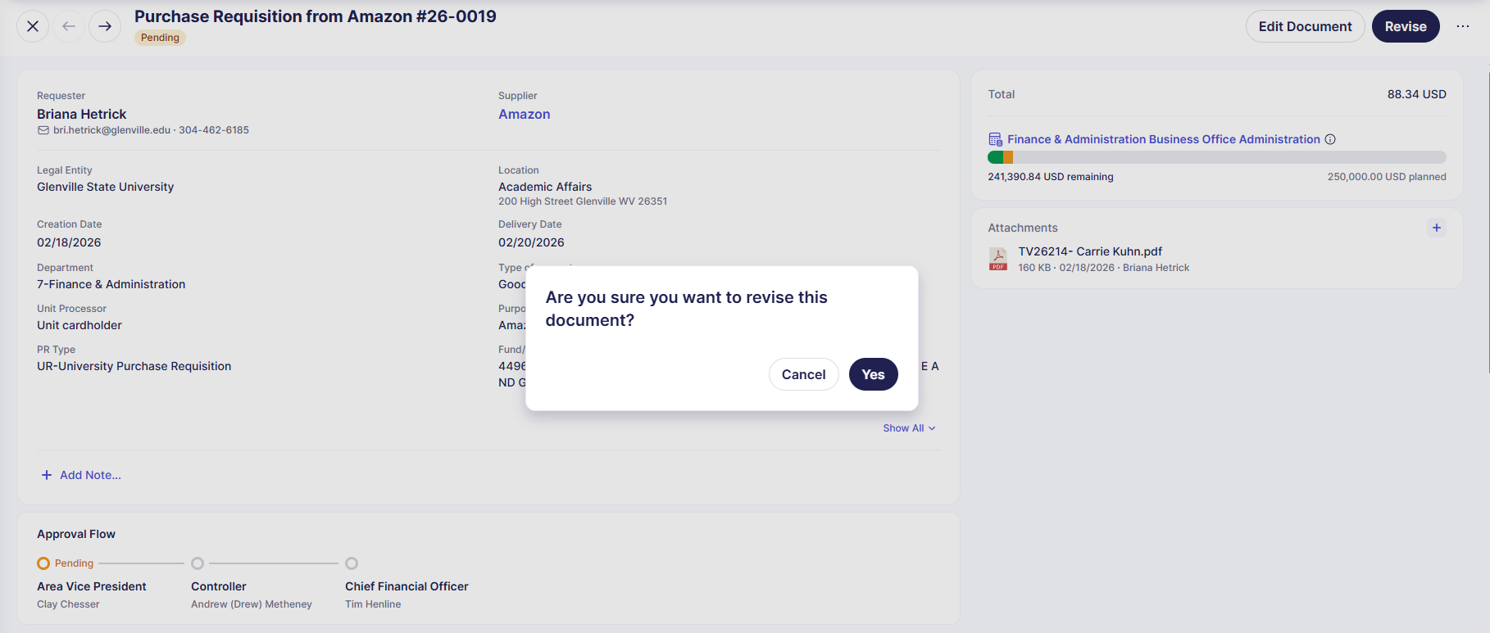
Revising the Purchase Requisition
If you need to change something in your requisition after it is submitted (change the items, quantities, etc.) use the Revise button to be able to edit the document.
The confirmation box will appear,
asking you if you’re sure that you’d
like to revise the document. Click
Yes , or Cancel if you reconsidered.
If you need to check any changes
that may have happened to your
requisition, you can check it
through Revision History.

Slide 32
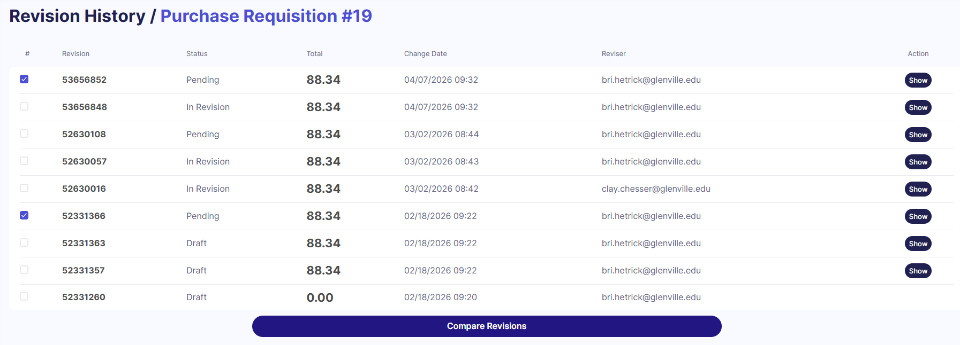
Purchase Requisition Revision History
Precoro has the capability to provide an audit trail of all changes to the Purchase Requisition.
To view revision changes:
Navigate to the Purchase Requisition you wish to see the revision history.
2. Click on “Revision History” from the right side of the screen. This will bring up all the changes to the Purchase Requisition.
3. Click on Show , located on the far right side of the screen to view revision details. The PR page will appear. You can click “Show Changes Only” to see what has changed.
If you wish to compare 2 revisions, that can be done by clicking the boxes to the left of the revision # and selecting Compare Revisions .

Slide 33
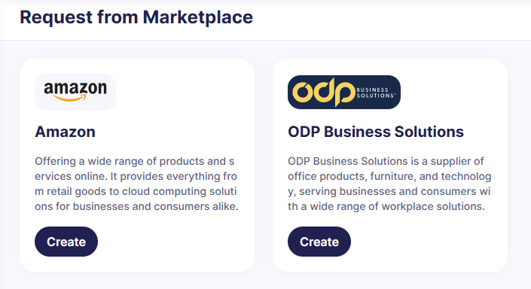
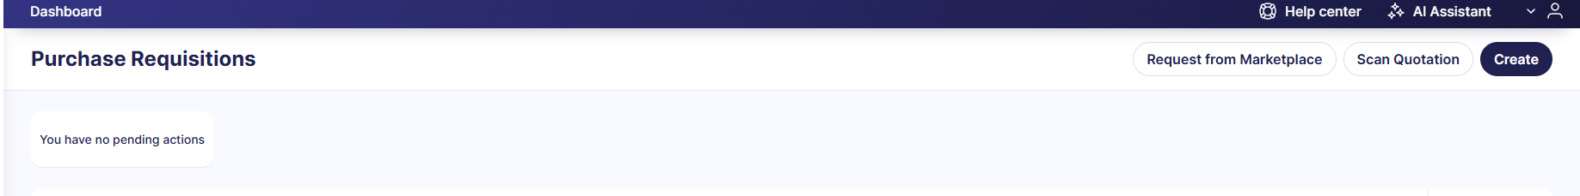
Creating a Punchout Purchase Requisition
If you need an item from the Marketplace:
On the left-side menu, select the Purchase Requisition module.
Click Request from Marketplace button.
Select the preferred vendor for this request and hit Create.
This action will bring you to the PR form you have to fill out prior to transferring to the catalog of the selected marketplace.

Slide 34
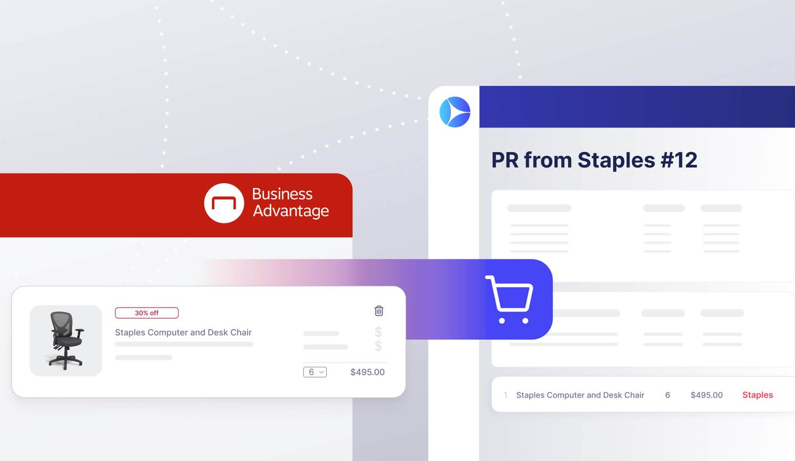
Creating a Punchout Purchase Requisition (Continued)
Once the header is complete. Precoro will take you to the marketplace for you to add everything into your cart. After you hit submit it will redirect you back to the Purchase Requisition to finish completing the document.
Once approved, the PRs from Marketplaces automatically get created as a PO, and the buyer has to review the document, implement the necessary changes, and confirm it.
This way, the order will be directed to the marketplace and automatically placed there.

Slide 35
FAQ: Incorrect Punchout Order
I accidentally ordered wrong items through the punch-out. I don't need them – how do I reflect this in Precoro?
(Outside Precoro) In case the wrong items were ordered and received, contact the supplier and arrange for the order cancellation.
Request the Buyer to Cancel the PO in Precoro. Then, Cancel the PR in Precoro.
Create a new punch-out Requisition with proper items. The PR has to be approved.
The Buyer has to confirm the punchout PO.
Await for the delivery – once it happens, add the Receipt to the PO.

Slide 36
Tracking Purchase Requisitions by Status
You can track Purchase Requisitions in Precoro by referencing their statuses:
Draft - means your document has been created,
but not yet submitted and not sent for approval/purchasing. At this stage you can easily make changes to the document and delete it without capturing it in the system.
Pending - appears once you have confirmed the document. It means, that the document is waiting for the approval from your management.
In Revision - appears when the requestor or approver revises the document on their own; or when an approver sends the document to the requestor to make changes to it.
Rejected - your document was not approved and will therefore not be purchased.
Cancelled - the document was cancelled and is no longer relevant.
.Approved - means that your document was approved and now the team will start working on the request.
Completed - means that the request has been delivered and purchased.

Slide 37
Purchase Orders

Slide 38
How to Track a Purchase Order
You may track your purchase order in Precoro using statuses:
Draft - means your order has been created, but not submitted yet and not sent for approval.
Pending - means that your purchase order is waiting for the approval, and appears once the purchase order has been confirmed.
Rejected - means that your purchase order was not approved. It will not be purchased.
Approved - means that your purchase order was approved. Once your purchase order is approved, you will get an email notification.
In Revision - means that the PO is being revised and needs
to be confirmed.
Partly Received/ Received - means that the PO has been marked as received or partly received (depending on the amount of received items).
Complete - means that your purchase order has been purchased and delivered so no one can edit it anymore.
*Purchase Orders will be created by the Director of Purchasing

Slide 39
Receipts (Receiving Reports)

Slide 40
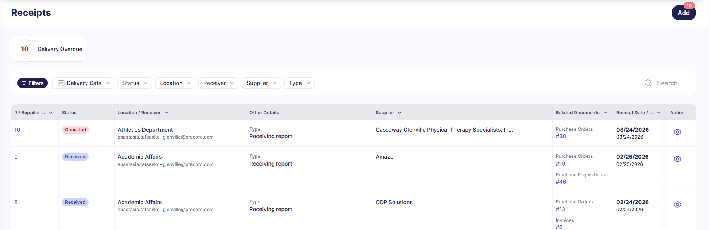
Receipts
Once a Purchase Order is in the Approved status, Receipt(s) can be attached against them.
Receipt creation is facilitated by the Requesters and serve to confirm that the ordered items were properly received and accounted for.

Slide 41
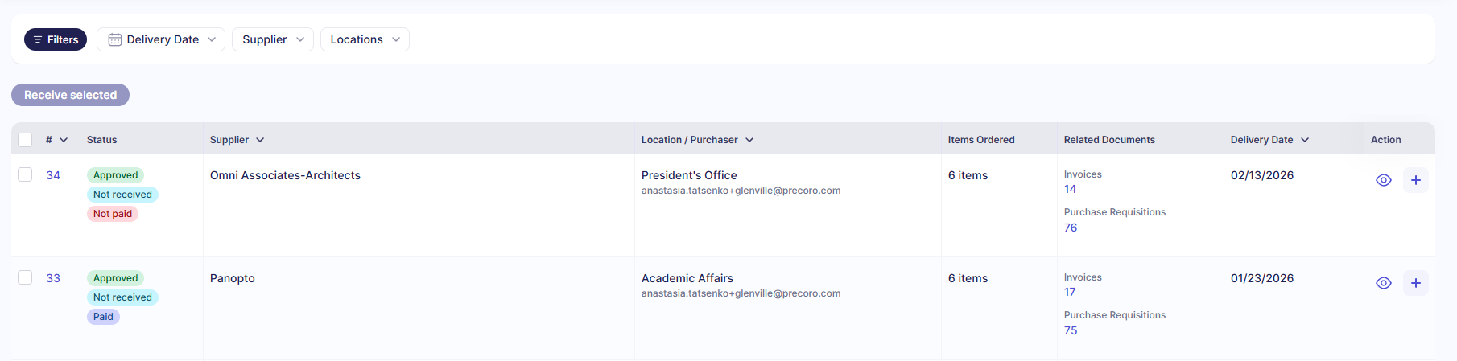
Receipt Creation
Upon receipt of goods from a Supplier, they must be received into Precoro. This will serve as part of the 3-way match for an invoice to be paid.
To add a receipt to the PO:
Click on the left-side Navigation bar in Precoro and select “Receipts”
On the Receipt page in the top-right corner, click the Add button.
A dashboard of POs to receive against will appear. Find the relevant PO to receive the product against. You can also use the Filters for faster identification.
Once the correct PO was located, click the plus sign on the right side of the page under the Action column.

Slide 42
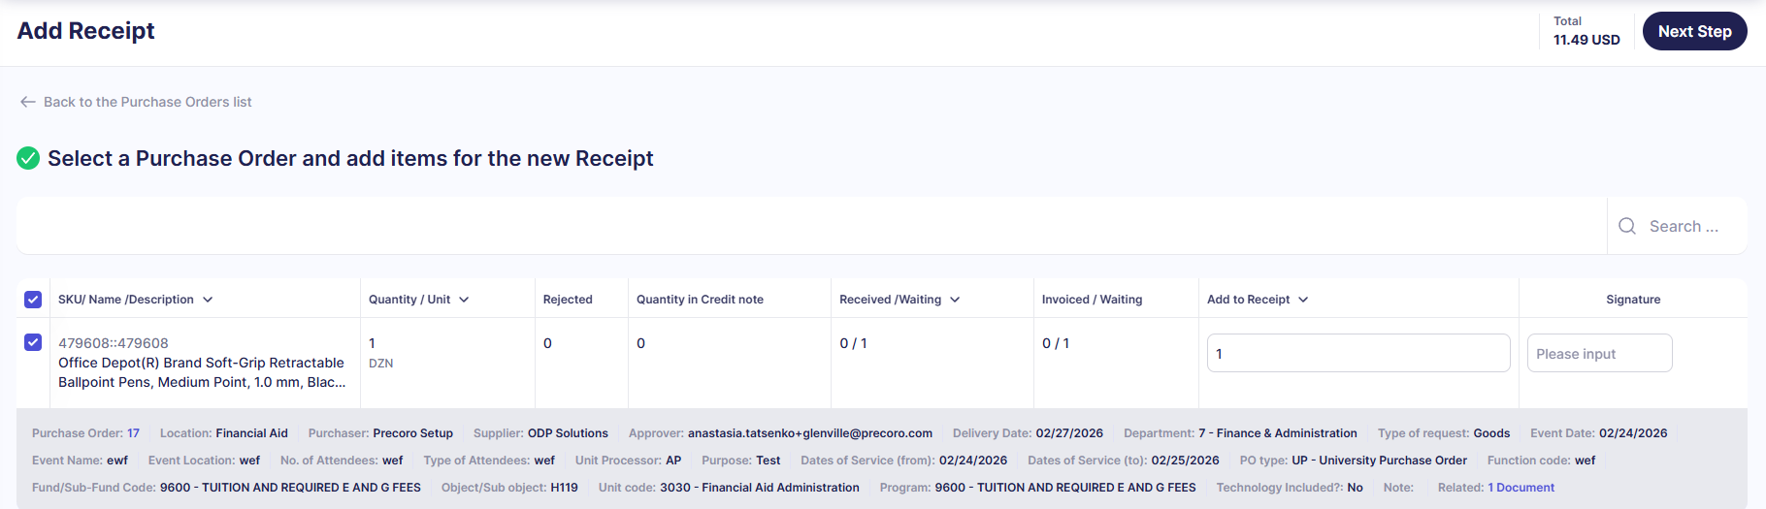
Identify Received Items & Quantities
Check the box to the left of the line item for the lines you have received.
Scroll to “Add to Receipt” field and enter the received quantity.
Click Next Step in the upper right corner to bring up the Supplier receipt details

Slide 43
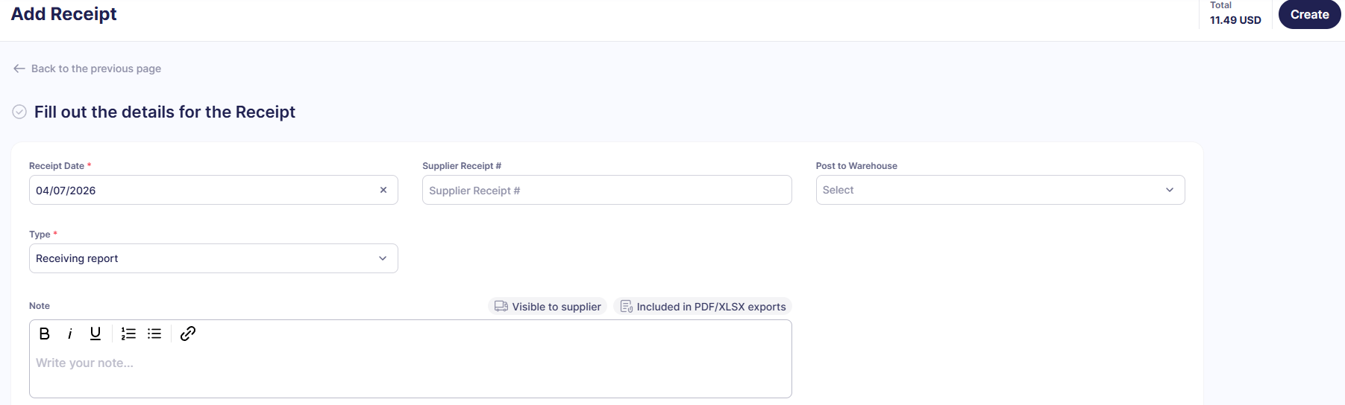
Receipt Header Creation
On this page, specify the following information:
Receipt Date: date the goods were received (the date defaults to current date but can be edited)
Supplier Receipt #: Can be left empty, if not provided on the packing list or receipt.
Post to Warehouse: Will always be pre-populated, leave blank.
Once done, click on Create in the top-right corner to Create the receipt record.

Slide 44
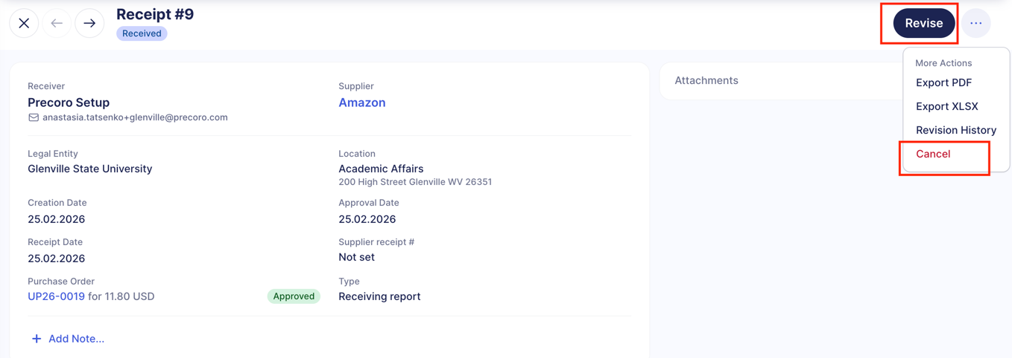
Receipt: Revision or Cancellation
Once a Receipt is completed in Precoro, it will have a status of Received..
If a change is needed to a receipt, go back into the Receipt & click the Revise button.
You will be asked to confirm your request to revise the Receipt. Click Yes .
In case you’ve made a Receipt mistakenly or it is no more relevant for you, you can Cancel it and start again. You will be asked to provide a comment as to why the Receipt is being cancelled. Click Yes to confirm the cancellation.
Note: Canceled Receipts cannot be retrieved.

Slide 45
Tracking Receipts by Status
You can track Receipts in Precoro by referencing their statuses:
Draft - means your Receipt has been created,
but not yet confirmed. You must attach the packing slip to the Receipt record. Once you do, you can confirm the Receipt.
Matching - appears when there is a discrepancy between the Receipt and the PO (more items received, then ordered). The Buyer has to accept matching before the Receipt can be further processed.
In Revision - appears if the Receipt originator or the buyer revise the Receipt to implement the necessary changes (for example, change of quantities, dates, etc.).
Cancelled - the document was cancelled and is no longer relevant.
Rejected - the Receipt was rejected while in matching.
Received. - the Receipt matched to the PO, and the delivery was successfully indicated.

Slide 46
Invoices

Slide 47
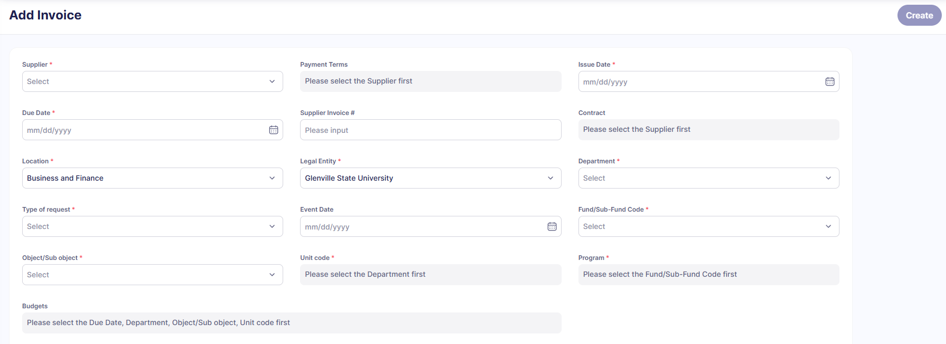
Invoice Creation
To add an Invoice to Precoro:
Click on the left-side Navigation bar in Precoro and select “Invoices”
On the Receipt page in the top-right corner, click the Add button.
Fill out the required fields on the header section.
Once completed, click the Create button located at the top-right corner.

Slide 48

Invoice Creation
To add a line item, click the “Add” button under the header and manually enter your items. When you’re finished, click the check‑mark icon under the Action column to save the items.
After all invoice items have been entered and attachment has been added, click Confirm in the top‑right corner to proceed.

Slide 49


Invoice Creation- Add from Purchase Order
To add an Invoice to Precoro by Purchase Order:
Click on the left-side Navigation bar in Precoro and select “Invoices”
On the Receipt page in the top-right corner, click the Add from PO button.
Select corresponding Purchase Orders that matches your invoice
Once completed, click the Next Step button located at the top-right corner.

Slide 50

Invoice Creation- Add from Purchase Order
4. Select all items that are included on the invoice and then proceed to next step.
5. Complete Header Information. Once finished, hit create in the top-right corner

Slide 51


Invoice Creation- Add Invoice with OCR
To add an Invoice to Precoro OCR:
Click on the left-side Navigation bar in Precoro and select “Invoices”
On the Receipt page in the top-right corner, click the Add from OCR button.
Complete the header information, add attachments and hit create.
After this step, the system will start the 3-way match process.

Slide 52
Travel Authorizations (Expenses)

Slide 53

Expense Creation
When you are planning a business trip, you will need to create an internal request for the trip’s approval.
Head over to the Expenses module in Precoro and hit “Create”

Slide 54

Expense Creation
Fill out all the necessary fields for your travels and hit Create button.

Slide 55

Expense Creation
On the 2nd step you will need to add expense items.
Click “Add” button to add each new item.
When you are filling out the meal per diem- make sure you are following GSA per diem. You can break it out by day in the section below that says “Select”. Hit confirm when finished adding all travel details.

Slide 56


Revising Expense Document
You can “Revise” your document if the expense items or the fields need to be updated.
If you would like to add a comment to your approvers, head over to the Comments section below the document and tag the person with @ sign and leave your message to them.
The approvers can also send this request back to you for revision if they have questions prior to their approval. You will receive an email notification to update the document and then you will be able to resubmit it for approval.

Slide 57

Travel Request Creation
Once all the approvers approve the travel request - you will receive an email notification.
The travel request status will change to “Approved”
**After your travel has been completed, you are still required to submit a Travel Expense Settlement Form (TES) whether or not you are requesting a reimbursement.

